Slide 1

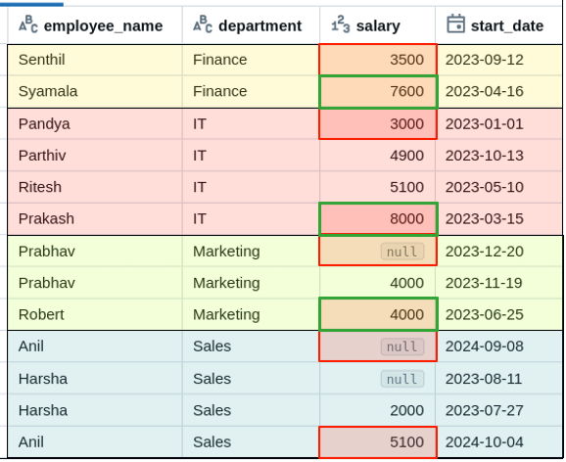

first() | last()
Window Functions
How to get first & last values
of column using first() & last()?
df_window_ignore = df\
.withColumn("first_salary", first("salary", ignorenulls=True)
.over(Window.partitionBy("department"))) \
.withColumn("last_salary", last("salary", ignorenulls=True)
.over(Window.partitionBy("department"))) \
.orderBy("department")

